Slide 1
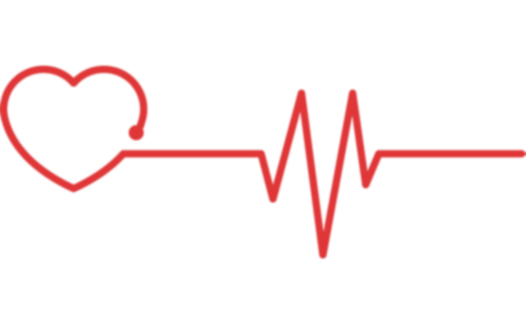
Heart Disease Risk Detection using Android Wear
Project Presentation
Presented By:
Abhishek Manoj Sharma
Nivetha Vijayaraju
Parth Jayantilal Jain

Slide 2
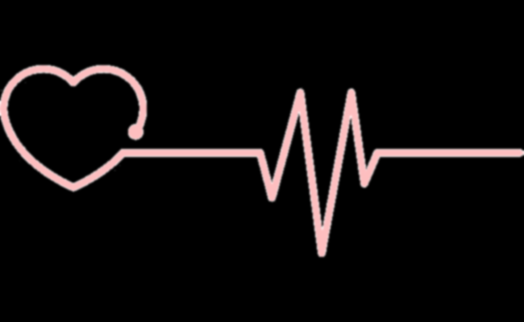
The Problem
Number of patients suffering from heart issues is rising since 2008.
About 610,000 people per year die of heart diseases in the US.
Reasons:
Lack of awareness about heart disease symptoms
Lack of real-time solutions to track heart health

Slide 3
Research Importance
According to Centers for Disease Control and Prevention (CDC):
1 out of every 4 deaths in the U.S. is caused by heart and cardiovascular diseases.
Only 27% of respondents called the emergency helpline.
47% of cardiac deaths occur due to lack of early detection.

Slide 4
Research Questions
How can Artificial Intelligence improve heart health tracking?
What are the limitations in doing so?

Slide 5




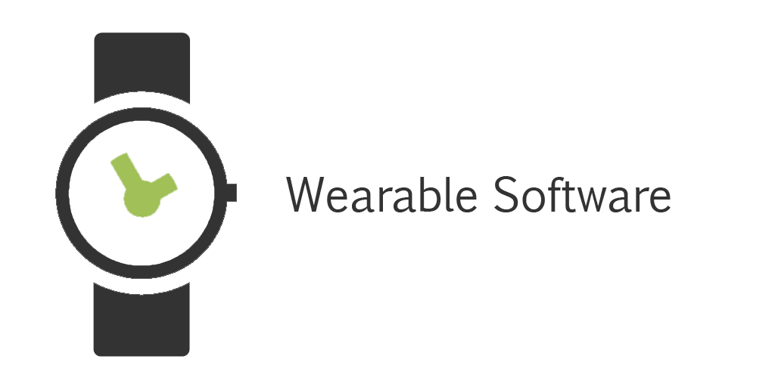
Architecture
3. Create local copy of dataset for prediction
Prediction Agent
Training Dataset
4. Write prediction
2. Read user values
1. Write user values
5. Send predicted value
Firebase Database
Android Wear
Android Smartphone

Slide 6

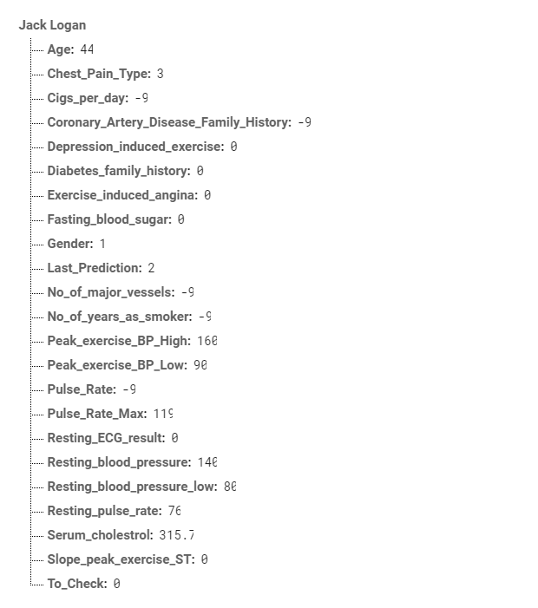
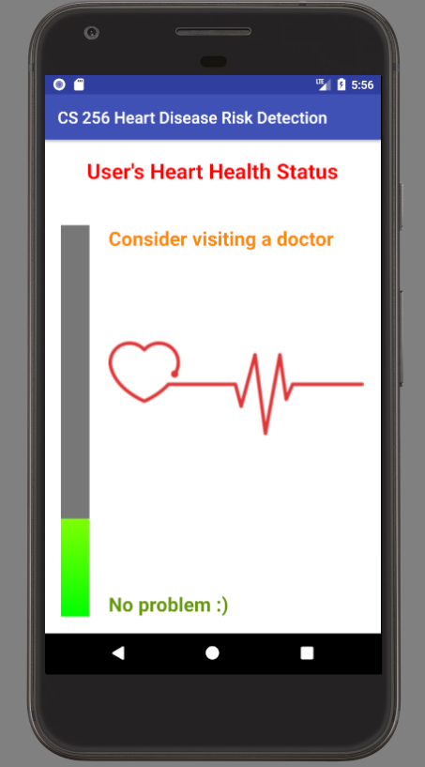
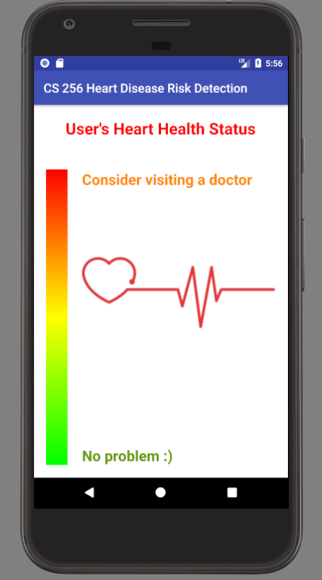
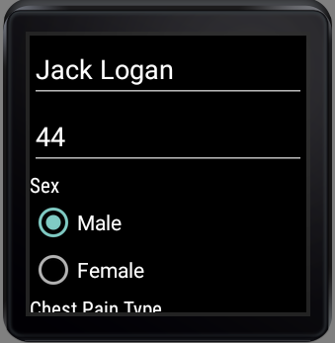
Prototype: User Interface
Frontend
Backend

Slide 7
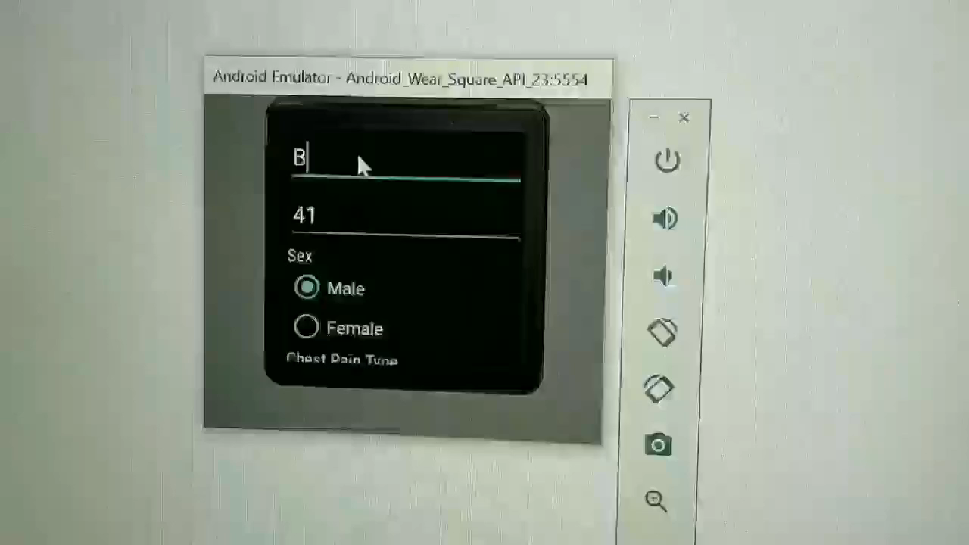
Prototype: Demo

Slide 8
Performance Evaluation
METHODOLOGY
Used 10-fold validation for calculating the accuracy.
Calculated average accuracy for different values of ‘k’ on every fold to determine the optimal ‘k’ value for kNN.

Slide 9
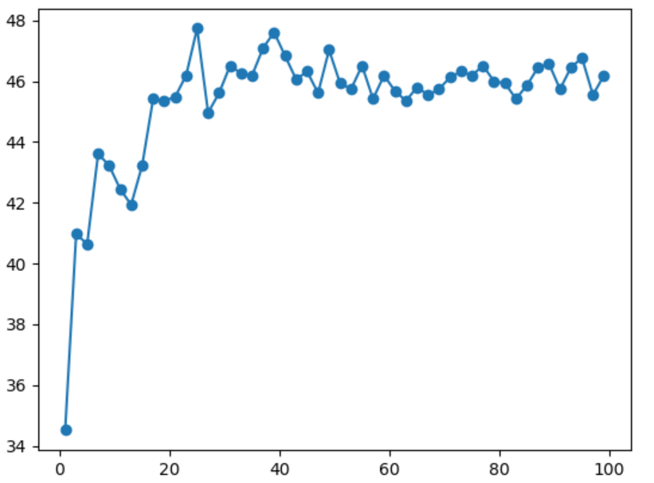
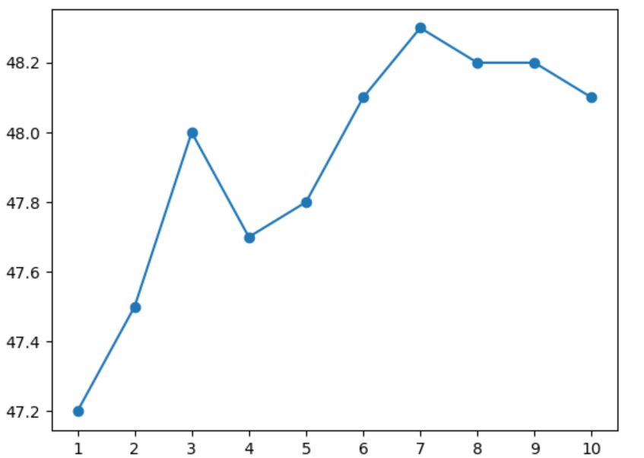
Performance Evaluation
RESULTS
Accuracy vs K
Accuracy vs Folds (for K = 25)
Accuracy (%)
Accuracy (%)
Value of K
Fold number

Slide 10
Remaining Challenges
Improving the accuracy by getting more data.
Testing on real users.
Testing on people from diverse backgrounds.

Slide 11
Remaining Opportunities
Integrating application with medical practitioners for high risk users.
Developing the application on other platforms for a bigger userbase.

Slide 12
Thank You
Stay Healthy!

